Slide 1
One-Dimensional Continuous Motion
Dr. Jacob Moore
Associate Professor of Engineering
Penn State Mont Alto

Slide 2
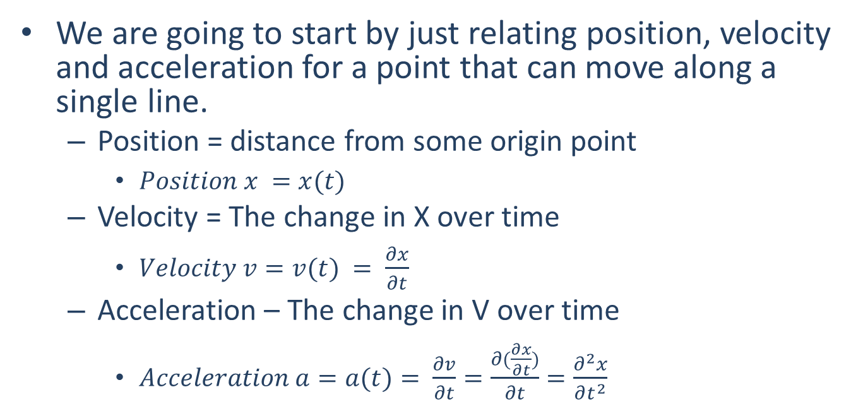
Kinematics
We are going to start by just relating position, velocity and acceleration for a point that can move along a single line.
Position = distance from some origin point
$Position x =x(t)$
Velocity = The change in X over time
$Velocity v=v(t) = \frac{∂x}{∂t}$
Acceleration – The change in V over time
$Acceleration a=a(t)= \frac{∂v}{∂t}=\frac{∂(\frac{∂x}{∂t})}{∂t}=\frac{∂^{2}x}{∂t^{2}}$
p
o
x

Slide 3

Shorthand Symbols
Position : $x(t)$
Velocity : $v\left(t\right)=\frac{dx}{dt}=\dot{x}$(t)
Acceleration : $a(t)=\frac{dv}{dt}=\frac{d^{2}x}{dt^{2}}=\ddot{x}$(t)

Slide 4
Transferring Among Position, Velocity, and Acceleration.
Kinematics problems almost always involve the following process below.
Given that the (position / velocity / acceleration) is described by the function f(t), find it’s (position / velocity / acceleration) over that same time period.
The process of going from one to another is the core of Kinematics.

Slide 5
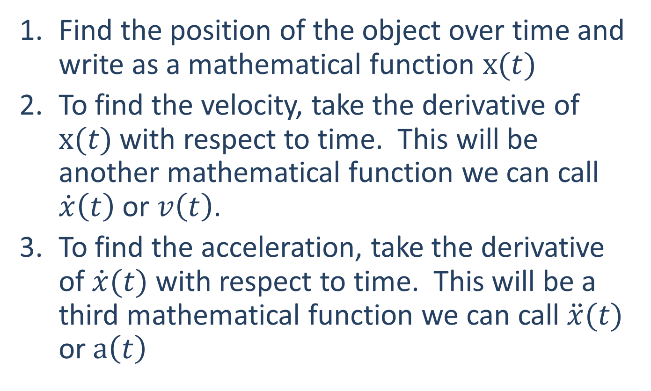
Position → Velocity → Acceleration
Find the position of the object over time and write as a mathematical function $x(t)$
To find the velocity, take the derivative of $x(t)$ with respect to time. This will be another mathematical function we can call $\dot{x}\left(t\right)$ or $v\left(t\right)$.
To find the acceleration, take the derivative of $\dot{x}(t)$ with respect to time. This will be a third mathematical function we can call $\ddot{x}(t)$ or $a\left(t\right)$

Slide 6
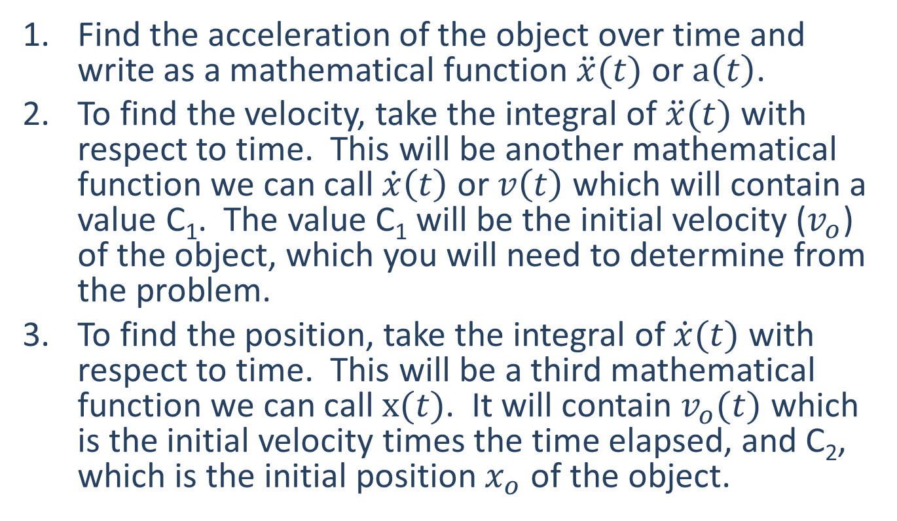
Acceleration → Velocity → Position
Find the acceleration of the object over time and write as a mathematical function $\ddot{x}(t)$ or $a\left(t\right)$.
To find the velocity, take the integral of $\ddot{x}(t)$ with respect to time. This will be another mathematical function we can call $\dot{x}\left(t\right)$ or $v\left(t\right)$which will contain a value C₁. The value C₁ will be the initial velocity ($v_{o}$) of the object, which you will need to determine from the problem.
To find the position, take the integral of $\dot{x}(t)$ with respect to time. This will be a third mathematical function we can call $x(t)$. It will contain $v_{o}(t)$ which is the initial velocity times the time elapsed, and C₂, which is the initial position $x_{o}$ of the object.

Slide 7
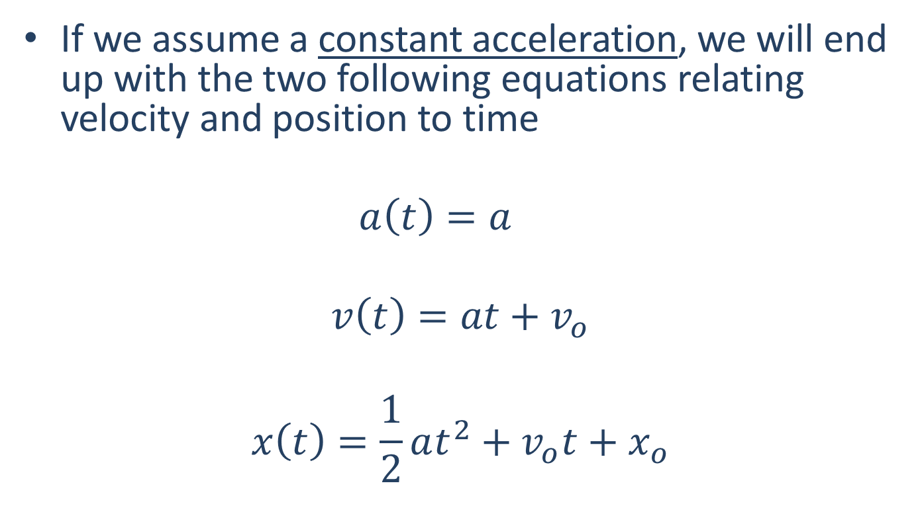
Constant Acceleration Equations
If we assume a constant acceleration, we will end up with the two following equations relating velocity and position to time
$$a\left(t\right)=a$$
$$v\left(t\right)=at+v_{o}$$
$$x\left(t\right)=\frac{1}{2}at^{2}+v_{o}t+x_{o}$$

Slide 8
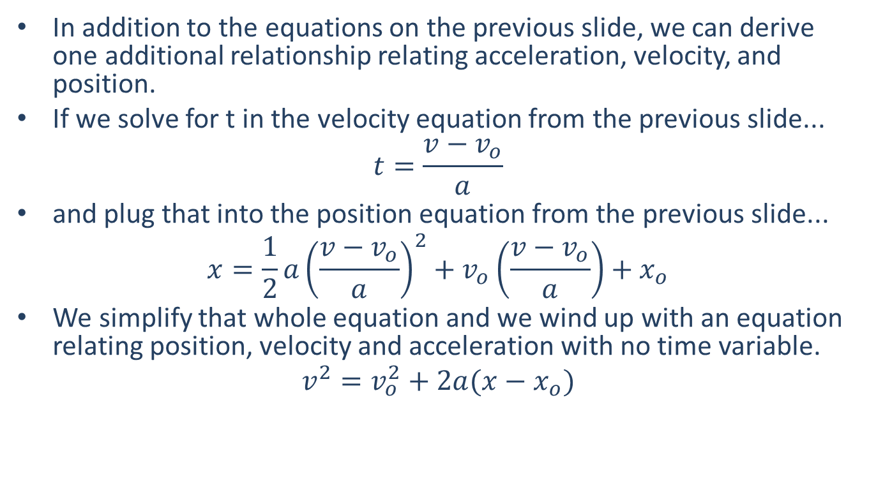
Constant Acceleration Equations
In addition to the equations on the previous slide, we can derive one additional relationship relating acceleration, velocity, and position.
If we solve for t in the velocity equation from the previous slide...
$$t=\frac{v−v_{o}}{a}$$
and plug that into the position equation from the previous slide...
$$x=\frac{1}{2}a{\left(\frac{v−v_{o}}{a}\right)}^{2}+v_{o}\left(\frac{v−v_{o}}{a}\right)+x_{o}$$
We simplify that whole equation and we wind up with an equation relating position, velocity and acceleration with no time variable.
$$v^{2}=v_{o}^{2}+2a(x−x_{o})$$

Slide 9
Thanks for Watching
See other engineering mechanics videos and access the full tool at…

Slide 10

Worked Example
You are in a van that steadily accelerates from 20 m/s to 35 m/s over the course of 10 seconds. What is the rate of acceleration?

Slide 11
Worked Example
You are in a van that steadily accelerates from 20 m/s to 35 m/s over the course of 10 seconds. How far did you travel in meters over the course of those ten seconds?

Slide 12
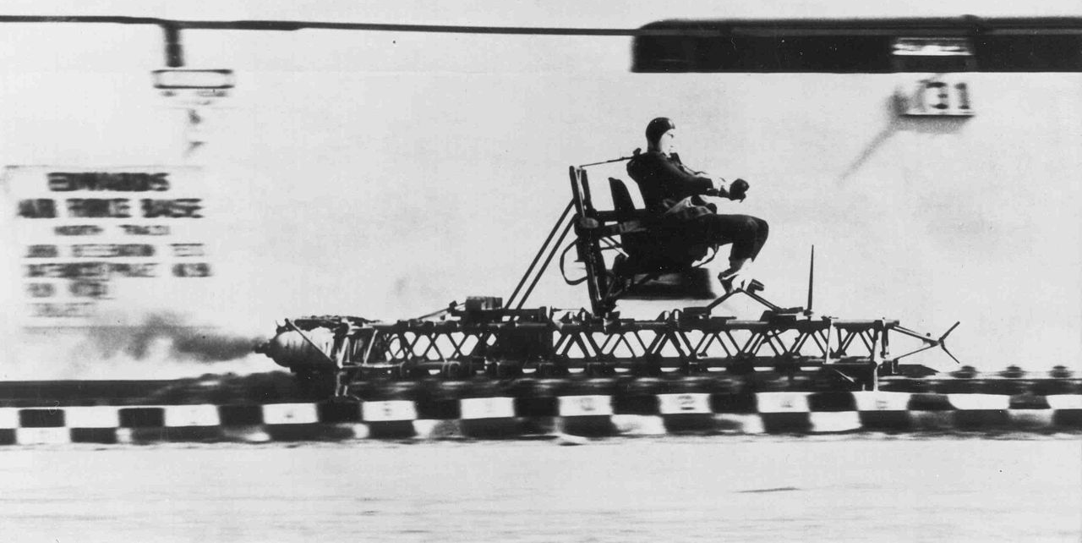
Worked Example
In a rocket sled deceleration experiment, a manned sled is decelerated from a speed of 200 mph (89.4 m/s) to a stop at a constant rate of 18 Gs (176.6 m/s²).
How long does it take for the sled to stop?
How far does the sled travel while decelerating?

Slide 13


Worked Example
An object is released from rest at the top of a tall building of unknown height. Using a precision stopwatch, you note that it takes 2.5 seconds for the object to hit the ground. Assuming the standard rate of acceleration of 32.2 ft/s² and negligible air resistance, what is the estimated height of the building in feet?
$$h=?$$
$$t=2.5s$$

Slide 14
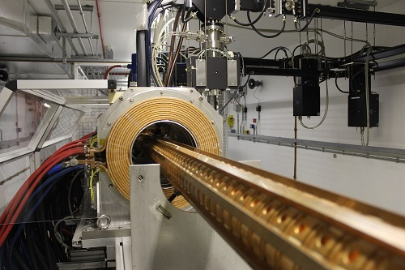
Worked Example
A metallic particle is accelerated in a magnetic field such that its velocity over time is defined by the function v(t) = 4t² - 12, where time is in seconds and velocity is in meters per second. If we assume that the particle has an initial position of zero (x₀ = 0), what are the equations that describe the acceleration and position over time?

